Slide 1
Capsule Night
Mr. Andrew Ginnard
6th/8th English Language Arts

Slide 2
Overview
Curriculum
Writing practices
Reading practices
Grading policy
Class donations
Questions

Slide 3
Curriculum
6th
Genres: Fairytales/folktales, fantasy, action-adventure, realistic fiction, poetry
Novels: (Lit. circle options)
8th
Genres: Historical fiction, realistic fiction, science fiction, genocide, real-life writing
Novels: Chains, The Outsiders, The Giver, and “Diary of Anne Frank”

Slide 4
Writing Practices
Do-now daily writing prompts/ Composition notebooks
Final papers:
6th: fairytale, personal narrative, compare/contrast, persuasive/research
8th: literary analysis, persuasive/research, academic portfolio
Writer’s workshop, grammar, vocab, informal and formal writing assignments

Slide 5
SSR
Protected time
Low stakes (not tested)
Life-long readers
Meaningful, authentic reading experiences
MUST have their own book every day in every core academic class

Slide 6
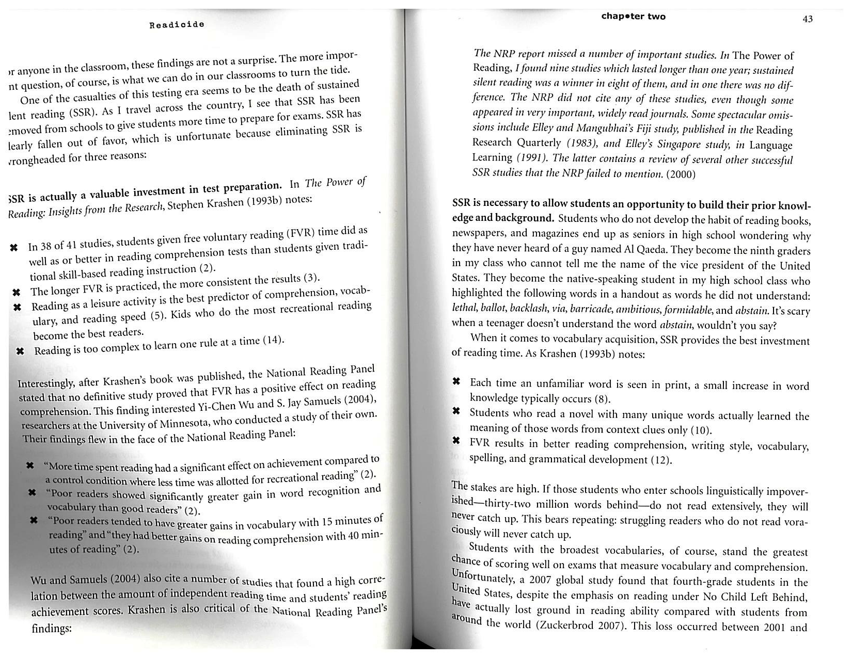

Slide 7
Grading Policy
Tests, final papers, projects, and presentations = 40%
Homework, quizzes, and classwork = 30%
Composition notebook (vocab, grammar, do nows) = 15%
Successful Student Strategies = 15%
Revisions
No extra credit

Slide 8
Grading Policy Cont.
I allow late work turned in within the unit of study
I allow revisions on almost all classwork/homework within the unit of study
Final assignment revisions will be discussed in detail after our first unit
Missing assignments will be marked with a “0” until submitted

Slide 9
Contact Info
ginnard@aaps.k12.mi.us
734-994-2007 x 34458
Before/after school availability
Don’t hesitate to make an appointment!
GinnardELA.weebly.com (will be updated shortly to reflect this school year!)

Slide 10
Class Donations
Books!
Class markers
Class colored pencils
Kleenex/Hand sanitizer/wipes ******
Post-its
Poster board
Composition notebooks
Books!

